Slide 1
CSE2026 - Data Handling and Visualization Review 0/Review 1
PROJECT TITLE :Investigating customer churn in banking
Batch: 8ISE02
Reviwer : Mrs.Poornima
Student Name – Roll number
Sridar S – 20201ISE0093
Vikas H – 20201ISE0056
Nishchay B N – 20201ISE0086

Slide 2
Investigating customer churn in banking

Slide 3
Introduction
Customer attrition, or churn, is when clients end their association with a business, notably in banking when they close accounts or cease services. Understanding and managing churn is vital for financial stability and reputation, as it leads to revenue loss and indicates underlying issues like poor experience or inefficiency. Monitoring churn aids in identifying at-risk customers, improving retention strategies, and enhancing overall customer lifetime value, crucial in the competitive banking landscape. Effective management mitigates reputation risks and fosters differentiation through tailored strategies, thus bolstering customer retention and profitability.

Slide 4
Problem Statement
The study primarily aims to address the challenge of maintaining customers and predicting their patterns, crucial for solving the customer attrition problem in the banking industry. Previous studies have discussed customer relationship management (CRM) systems and various retention approaches but lack comprehensive predictive models and visualization tools for effective management.

Slide 5
Project Overview
The research investigates customer churn in the banking sector using a machine learning approach and a visualization application for data science and management. It addresses the importance of acquiring and retaining customers for business success and focuses on predicting customer patterns to solve the problem of customer attrition.

Slide 6
Research Points
Algorithm Comparison
Feature Importance
Temporal Patterns
Customer Segmentation
Explainable AI
Real-time Monitoring
Feedback Analysis
Cross-Industry Comparison
Longitudinal Study
Ethical Considerations
Notes:
Summarize your research in three to five points.

Slide 7
Procedure
The research employs a comprehensive preprocessing method to ensure data correctness and consistency. It evaluates different machine learning (ML) methods for predicting customer attrition and develops a user-friendly visualization app to display churn-related insights. The dataset used comprises diverse customer attributes such as credit scores, demographics, and product ownership.
Notes:
List all of the steps used in completing your experiment.
Remember to number your steps.

Slide 8
Methodology
The study explores core ML techniques including logistic regression, support vector machine (SVM), random forest, and eXtreme Gradient Boosting (XGBoost) for churn prediction. It conducts data analysis, model training, and evaluation using various metrics such as accuracy, sensitivity, specificity, and area under the curve (AUC). Additionally, the research develops a visualization using PowerBI tool for stakeholders to make informed decisions based on churn analysis insights.

Slide 9
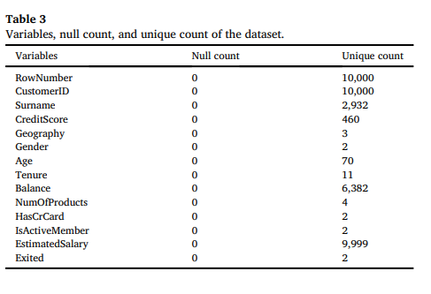
DATASET

Slide 10
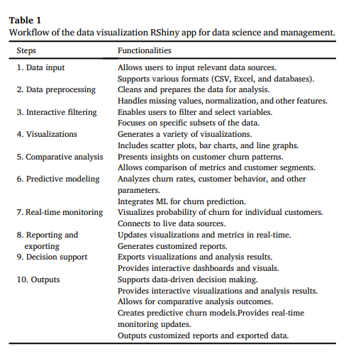

Slide 11
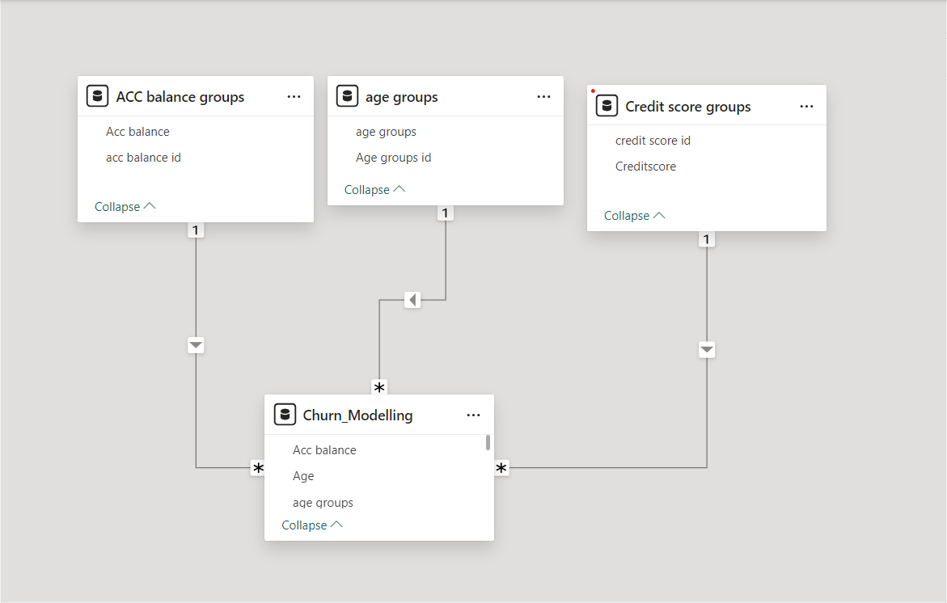
MODEL VIEW

Slide 12
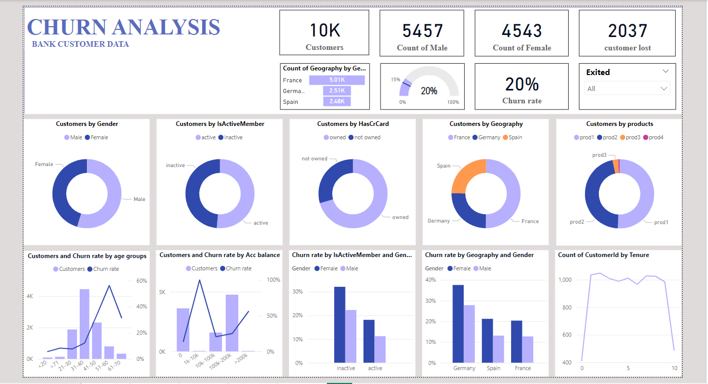
Dashboard

Slide 13
Conclusion
The research contributes to the body of knowledge by providing a comprehensive approach to customer churn analysis and ML utilization in the banking sector. It offers insights into data preprocessing, model evaluation, and visualization techniques for effective churn prediction and management. The study highlights the significance of understanding customer attrition factors and provides practical recommendations for improving client retention strategies in the banking industry and beyond.

